Slide 1

Shallow Neural Networks
Learning Objectives:
Describe hidden units and hidden layers
Use units with a non-linear activation function
Implement forward and backward propagation
Apply random initialization to your neural network
Increase fluency in Deep Learning notations and Neural Network Representations
Compute the cross entropy loss

Slide 2
1 Neural Networks Overview
2 Neural Network Representation
3 Computing a Neural Network’s Output
4 Vectorizing across multiple examples
5 Explanation for vectorized implementation
6 Activation functions
7 Why do you need non-linear activation functions?
8 Derivatives of activation functions
9 Gradient descent for neural networks
10 Backpropagation intuition (Optional)
11 Random Initialization
Shallow Neural Networks

Slide 3
One hidden layer Neural Network
Neural Networks Overview

Slide 4
What is a Neural Networks
A neural network, often referred to as an artificial neural network (ANN), is a computational model inspired by the way biological neural networks, like those found in the human brain, process information.
It is a powerful machine learning technique capable of learning complex patterns and making predictions or decisions based on input data.
A neural network is formed by stacking together multiple logistic regression-like computations (sigmoid units).

Slide 5


What is a Neural Networks
Elements of Neural Networks:
Neural networks consist of hidden layers with neurons (i.e., computational units)
A single neuron maps a set of inputs into an output number, or $f:R^{K}→R$
$$a=σ\left(z\right)$$
ℒ(a, y)
…
…
output
Activation function
weights
input
bias

Slide 6
One hidden layer Neural Network
Neural Network Representation

Slide 7
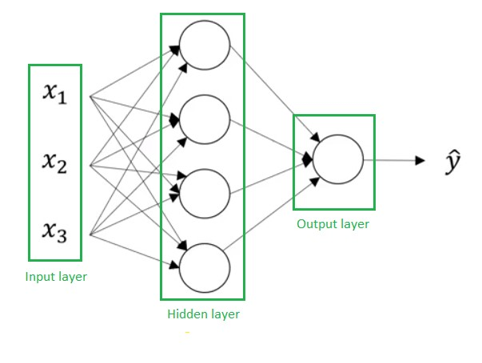
Neural Networks Representation
Consider a neural network with one hidden layer and one output layer
The key components of a neural network are the input layer, the hidden layer, and the output layer.
The hidden layer is so-called because its values are not observed in the training set.
Notes:
The key components of a neural network are the input layer, the hidden layer, and the output layer.
The hidden layer is so-called because its values are not observed in the training set.
Activations are introduced as the values passed between layers, with a superscript square bracket 0 representing input features, a superscript square bracket 1 representing the hidden layer activations, and a superscript square bracket 2 as the output.
A two-layer neural network refers to the number of layers excluding the input layer. The parameters associated with each layer (W and b), with their dimensions to be explained further in later slides.

Slide 8




Neural Network Representation
Elements of Neural Networks:
Weights
Biases
$$hidden layer h=σ(Wx+b)$$
$$output layer y=σ(Wh+b)$$
Activation functions
a^{[0]}$=x$
a^{[1]}$=h$
a^{[2]}$=ŷ$

Slide 9
Neural Networks Representation
Activations are introduced as the values passed between layers:
- a^{[0]} represents input features or layer 0
- a^{[1]} represents the hidden layer activations or layer 1
- a^{[2]} represents the output or layer 2.
A two-layer neural network refers to the number of layers excluding the input layer. The parameters associated with each layer (W and b), with their dimensions to be explained further in later slides.
a^{[0]}$=x$
a^{[1]}$=h$
a^{[2]}$=ŷ$
Notes:
The key components of a neural network are the input layer, the hidden layer, and the output layer.
The hidden layer is so-called because its values are not observed in the training set.
Activations are introduced as the values passed between layers, with a superscript square bracket 0 representing input features, a superscript square bracket 1 representing the hidden layer activations, and a superscript square bracket 2 as the output.
A two-layer neural network refers to the number of layers excluding the input layer. The parameters associated with each layer (W and b), with their dimensions to be explained further in later slides.

Slide 10
Neural Networks Representation
The first hidden layer is associated with parameters w^{[1]} and b^{[1]}. The dimensions of these matrices are:
- w^{[1]} is (4,3) matrix
- b^{[1]} is (4,1) matrix
Parameters w^{[2]} and b^{[2]} are associated with the second layer or actually with the output layer. The dimensions of parameters in the output layer are:
- w^{[2]} is (1,4) matrix
- b^{[2]} is a real number
a^{[0]}$=x$
a^{[1]}$=h$
a^{[2]}$=ŷ$
Notes:
The key components of a neural network are the input layer, the hidden layer, and the output layer.
The hidden layer is so-called because its values are not observed in the training set.
Activations are introduced as the values passed between layers, with a superscript square bracket 0 representing input features, a superscript square bracket 1 representing the hidden layer activations, and a superscript square bracket 2 as the output.
A two-layer neural network refers to the number of layers excluding the input layer. The parameters associated with each layer (W and b), with their dimensions to be explained further in later slides.

Slide 11
Neural Network Representation
Elements of Neural Networks:
4 + 1 = 6 neurons (not counting inputs)
[3 × 4] + [4 × 1] = 16 weights
4 + 1 = 5 biases
21 learnable parameters
a^{[0]}$=x$
a^{[1]}$=h$
a^{[2]}$=ŷ$

Slide 12
One hidden layer Neural Network
Computing a Neural Network’s Output

Slide 13
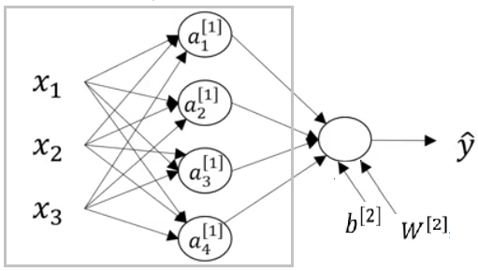
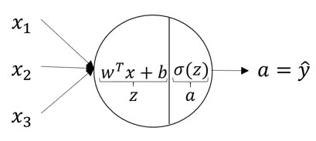

Computing a Neural Network’s Output
Equations of Hidden layers:
Each neuron will receive an input, perform some transformations on them (here, calculation Z = W^{[T]}x + b) then apply the sigmoid function (σ):
$$a^{[2]}$$

Slide 14
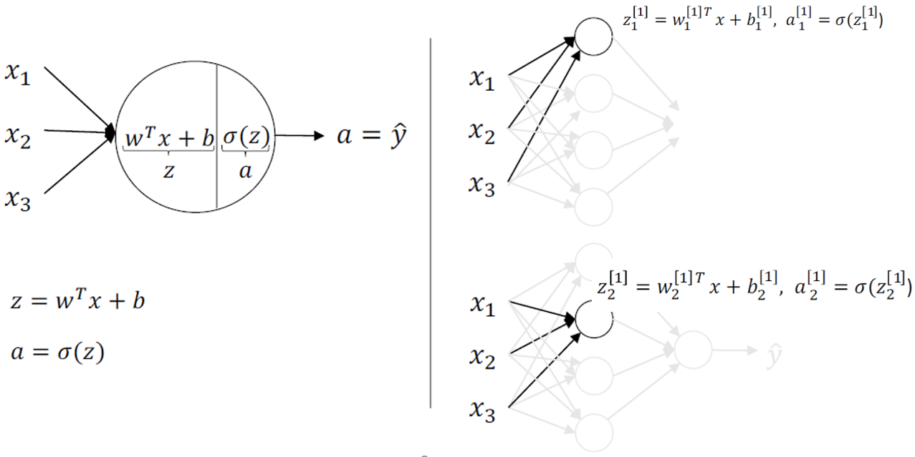
Computing a Neural Network’s Output
Equations of Hidden layers:

Slide 15
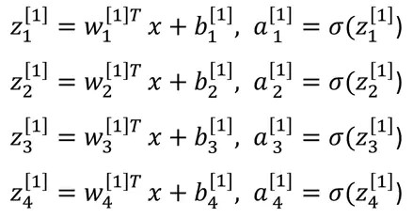

Computing a Neural Network’s Output
Equations of Hidden layers:
These steps will be performed on each nerve cell. The equations for the first hidden layer with 4 neurons will be:
$$a^{[2]}$$

Slide 16
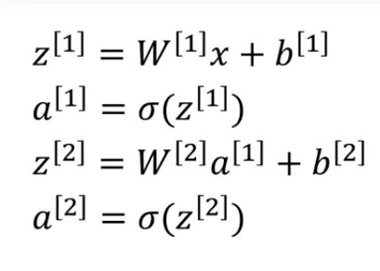

Computing a Neural Network’s Output
Equations of Hidden layers:
So, for given input X, the outputs of layer 1 and 2 will be:
$$a^{[2]}$$

Slide 17
Computing a Neural Network’s Output
Equations of Hidden layers:
noOfHiddenNeurons = 4
Nx = 3
Shapes of the variables:
- W^{[1]} is the matrix of the first hidden layer, it has a shape of (noOfHiddenNeurons, Nx)
- b^{[1]} is the matrix of the first hidden layer, it has a shape of (noOfHiddenNeurons,1)
- z^{[1]} is the result of the equation z^{[1]} = W^{[1]} *X + b, it has a shape of (noOfHiddenNeurons,1)
- a^{[1]} is the result of the equation a^{[1]} = σ(z^{[1]}), it has a shape of (noOfHiddenNeurons,1)
- W^{[2]} is the matrix of the second hidden layer, it has a shape of (1,noOfHiddenNeurons)
- b^{[2]} is the matrix of the second hidden layer, it has a shape of (1,1)
- z^{[2]} is the result of the equation z^{[2]} = W^{[2]} * a^{[1]} + b, it has a shape of (1,1)
- a^{[2]} is the result of the equation a^{[2]} = σ(z^{[2]}), it has a shape of (1,1)
$$a^{[2]}$$

Slide 18
One hidden layer Neural Network
Vectorizing across multiple examples

Slide 19
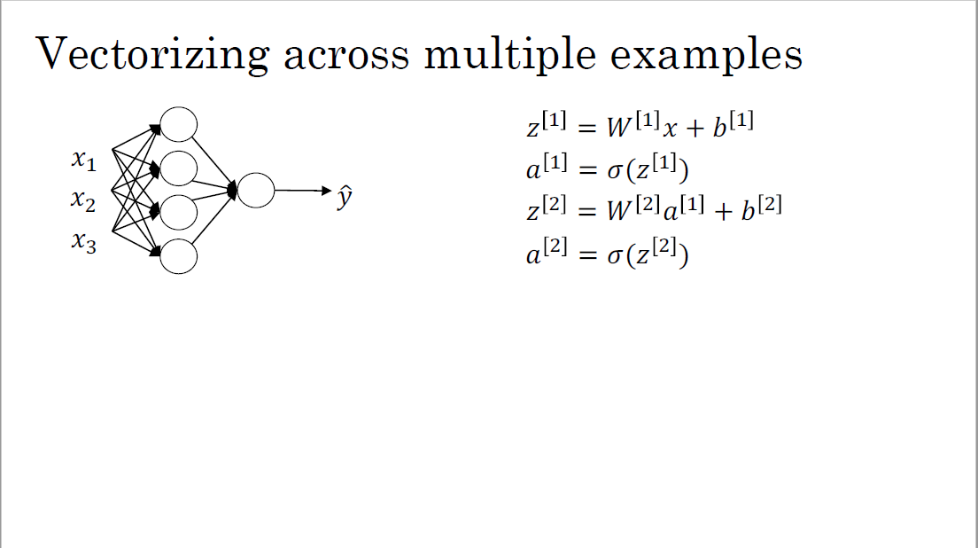

Slide 20
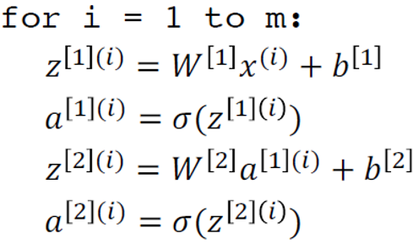
Four equations from the previous slide are used to compute z^{[1]} , a^{[1]} , z^{[2]} , and a^{[2]} . By adding a superscript round bracket i, ie (i), to all the variables that depend on the training example, outputs can be computed for all m training examples:
Vectorizing across multiple examples

Slide 21
Vectorizing across multiple examples
The goal is to vectorize the computation and get rid of the for loop. To achieve this, Z^{[1]} , A^{[1]} , Z^{[2]} , and A^{[2]} can be computed using matrixes:
- Matrix Z^{[1]} represents the output of the first layer for all examples
- Matrix A^{[1]} represents the activations of the first layer for all examples.
- Matrix Z^{[2]} represents the output of the second layer for all examples
- Matrix A^{[2]} represents the activations of the second layer for all examples.
By stacking up the lowercase vectors in different columns, you can obtain the matrices Z and A. The horizontal index in these matrices corresponds to different training examples, while the vertical index corresponds to different nodes in the neural network.

Slide 22
One hidden layer Neural Network
Explanation for vectorized
implementation

Slide 23
Explanation for vectorized implementation
Stacking training examples horizontally in the matrix X.
The matrix capital Z^{[1]} is formed by taking the vector x⁽¹⁾, x⁽²⁾ , and x⁽³⁾ (or more examples) and stacking them vertically.
The line z^{[1]} = w^{[1]} x + b^{[1]} is a correct vectorization of the first step of forward propagation.
Similar reasoning can be applied to the other lines of code, showing that they are also correct vectorizations.
There's a certain symmetry in the equations, which demonstrates that the different layers of a neural network are performing the same computation repeatedly.

Slide 24
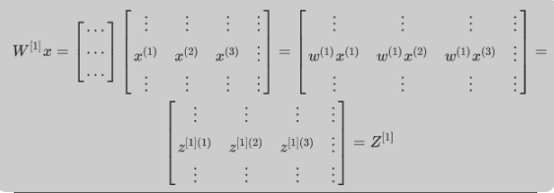
Explanation for vectorized implementation

Slide 25
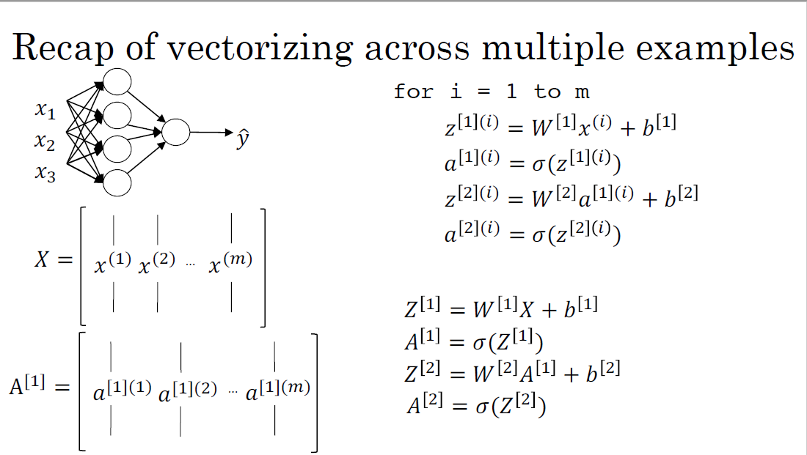

Slide 26
One hidden layer Neural Network
Activation functions

Slide 27
Activation functions
The sigmoid function was popular in the past, but it has been mostly replaced by other activation functions. The tanh function, which is a shifted version of the sigmoid, works better than the sigmoid for hidden layers as it centers the data with a mean close to zero. However, for the output layer in binary classification, the sigmoid function is still preferred.
The rectified linear unit (ReLU) is currently the most popular activation function for hidden layers due to its simplicity and ability to reduce the vanishing gradient problem. It is defined as a=max(0,z). The Leaky ReLU, a variant of ReLU, is also used in some cases, with a=max(0.01*z,z) instead. It offers a small slope for negative z values, which can help avoid dead neurons.

Slide 28
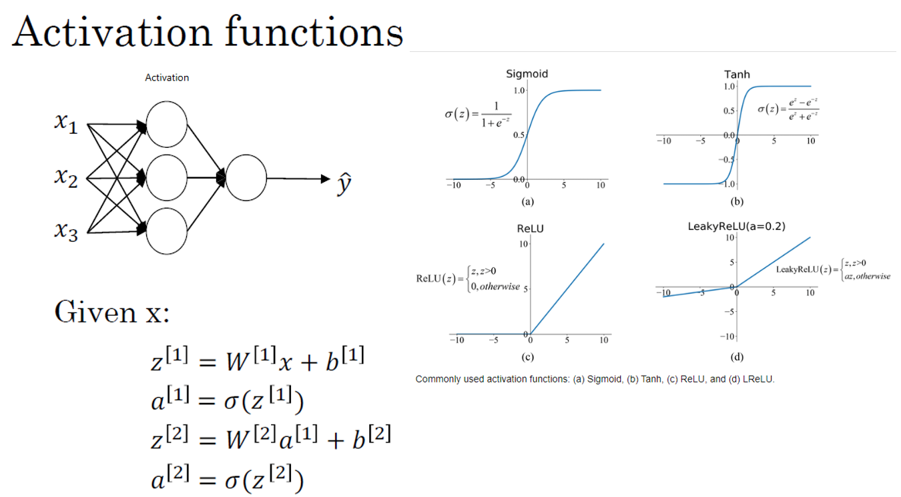

Slide 29
Activation functions
Some rules of thumb for choosing activation functions are:
- For binary classification output layers, use the sigmoid function.
- For hidden layers, the default choice is the ReLU function. The tanh function can also be used.
It is essential to experiment with different activation functions in your specific application to determine the best choice. This helps future-proof your neural network architecture against the idiosyncrasies of different problems and the evolution of algorithms.

Slide 30
One hidden layer Neural Network
Why do you need non-linear
activation functions?

Slide 31
Why do you need non-linear
activation functions?
If a linear or identity activation function is used, the neural network would only compute a linear function of the input, making hidden layers more or less useless. The composition of two linear functions is itself a linear function, so without a non-linear activation function, the network won't compute more interesting functions even with more layers.
A linear activation function might be used in the output layer if the problem is a regression problem where y is a real number, but hidden layers should still use non-linear activation functions such as ReLU, tanh, or Leaky ReLU.

Slide 32
One hidden layer Neural Network
Derivatives of activation functions

Slide 33

Derivatives of activation functions
The computation of slopes or derivatives of activation functions used in backpropagation for neural networks.
The Sigmoid activation function's slope is shown to be equal to
The Tanh activation function's slope is equal to
The ReLU activation function's derivative is 0 if x is less than 0 and 1 if x is greater than 0, and the Leaky ReLU activation function's derivative is 0.01 if x is less than 0 and 1 if x is greater than 0. It is noted that the derivative is technically undefined when x is exactly equal to 0, but in practice, it does not matter where the derivative is set.
Note: The shorthand notation f'(x) for the derivative of the function f(x) with respect to the input variable x.

Slide 34

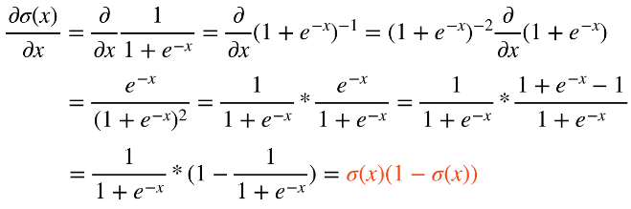
Sigmoid function

Slide 35

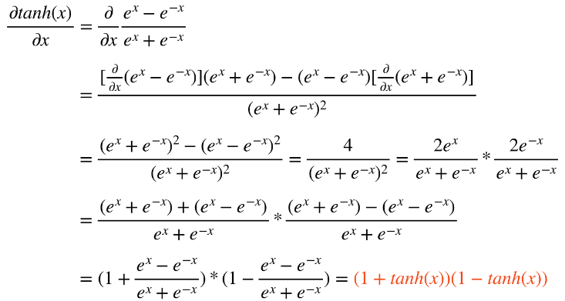
Tanh function

Slide 36

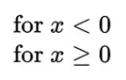

ReLU and Leaky ReLU function
ReLU
*
ReLU
Leaky ReLU

Slide 37
One hidden layer Neural Network
Gradient descent for neural networks

Slide 38
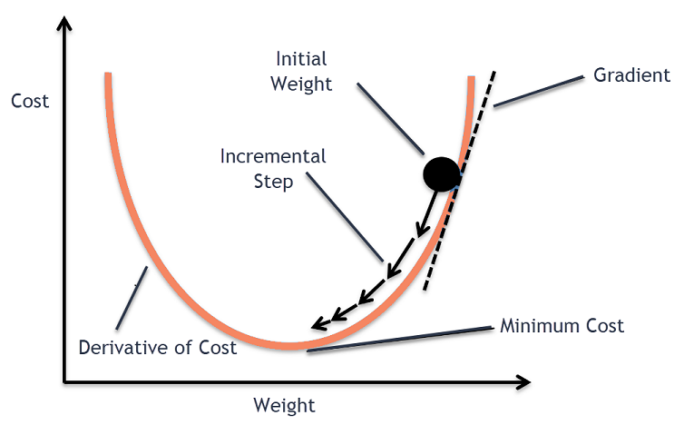
Gradient descent for neural networks

Slide 39
Gradient descent for neural networks

Slide 40
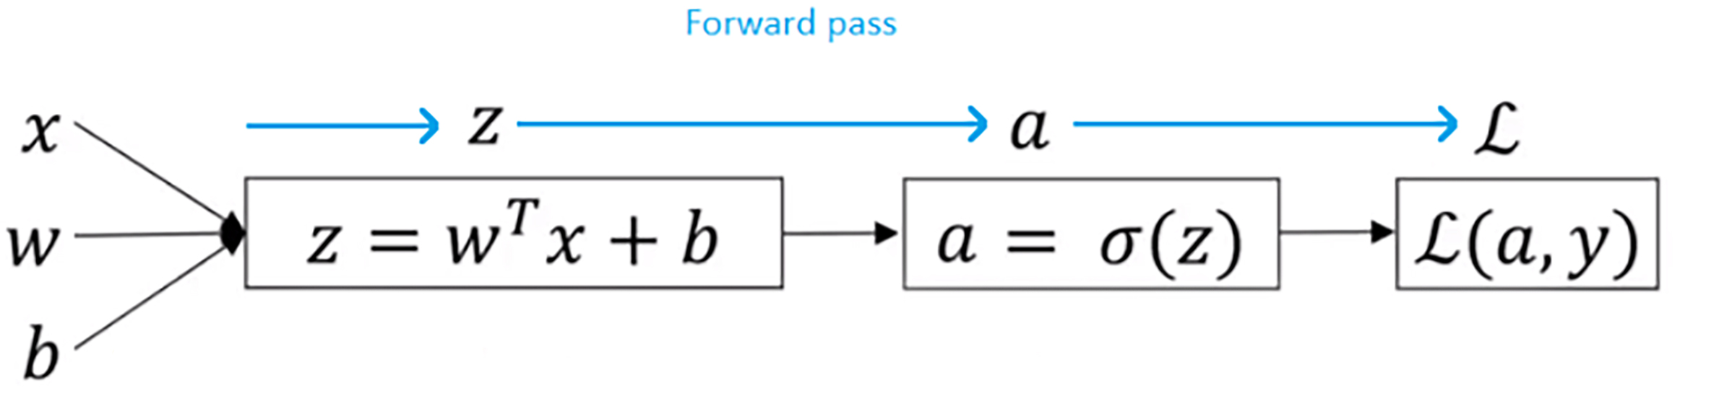
Formulas for computing derivatives
The forward and backpropagation of a 2-layer neural network:
Forward propagation:
Z^{[1]} = W^{[1]}X + b^{[1]}
A^{[1]} = g^{[1]}(Z^{[1]}) = σ(Z^{[1]})
Z^{[2]} = W^{[2]}A^{[1[} + b^{[2]}
A^{[2]} = g^{[2]}(Z^{[2]}) = σ(Z^{[2]})
Notes:
Also known as forward pass, is the process of transmitting input data through a neural network to generate an output prediction. It is the first step in the process of training a neural network.
During forward propagation, the input data is fed into the neural network and passed through the network's layers of interconnected neurons. Each neuron receives input from the neurons in the previous layer, performs a computation on that input, and then passes the output to the neurons in the next layer.
The computations performed by the neurons are determined by the weights and biases assigned to them during the training process. These weights and biases are adjusted during training to improve the accuracy of the network's predictions.
The output of the final layer of neurons is the predicted output of the neural network for the given input data.
This predicted output is compared to the actual output, and the difference between them is used to calculate the error. This error is then used to adjust the weights and biases of the neurons during the backward propagation process, which is used to update the neural network's parameters and improve its accuracy.

Slide 41
Formulas for computing derivatives
Backward propagation:
Also known as backpropagation or backprop, is the process of computing the gradient of the loss function with respect to the weights and biases of a neural network, so that the weights and biases can be updated during the training process.
During forward propagation, the input data is passed through the neural network, layer by layer, to produce an output. The output is compared to the expected output, and the difference between them is used to compute the loss function.
The goal of backpropagation is to compute the gradient of the loss function with respect to each weight and bias in the network.

Slide 42
Formulas for computing derivatives
Backward propagation:
To compute the gradients, backpropagation uses the chain rule of calculus to propagate the error back through the layers of the neural network.
- Starting at the output layer, the gradient of the loss function with respect to the output of each neuron is computed.
- These gradients are then used to compute the gradients with respect to the input to each neuron in the previous layer.
- This process is repeated until the gradient with respect to each weight and bias in the network is computed.

Slide 43
Formulas for computing derivatives
Backward propagation:
Once the gradients have been computed, they can be used to update the weights and biases of the network using an optimization algorithm, such as stochastic gradient descent, to minimize the loss function.
This process of forward propagation followed by backpropagation and weight updates is repeated many times during training until the network is able to make accurate predictions on new data.

Slide 44
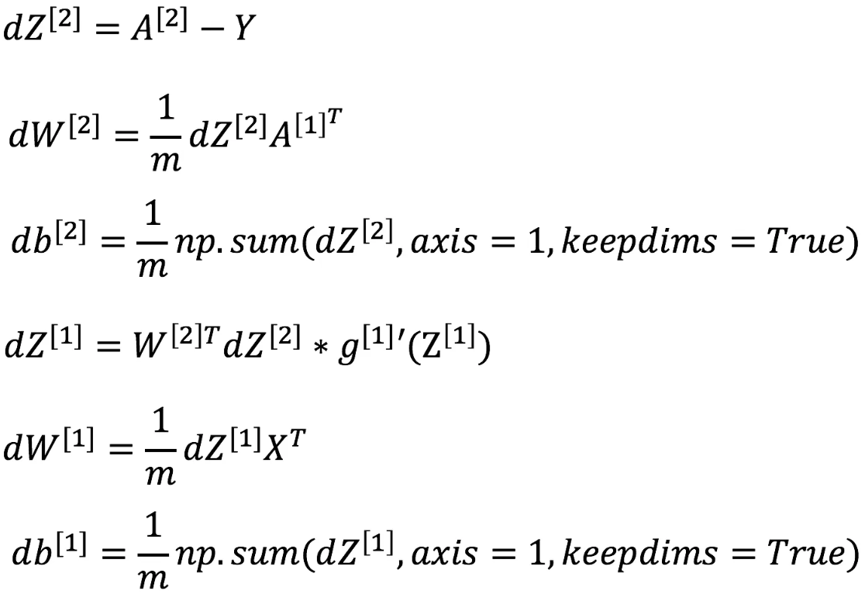
Formulas for computing derivatives
Forward propagation
Backward propagation
Z^{[1]} = W^{[1]}X + b^{[1]}
A^{[1]} = g^{[1]}(Z^{[1]})
Z^{[2]} = W^{[2]}A^{[1[} + b^{[2]}
A^{[2]} = g^{[2]}(Z^{[2]}) = σ(Z^{[2]})

Slide 45
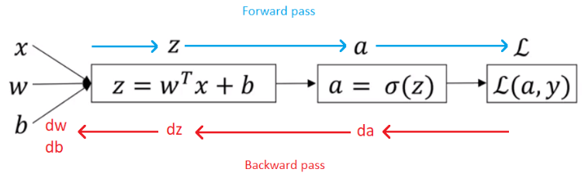
Formulas for computing derivatives

Slide 46
One hidden layer Neural Network
Backpropagation intuition (Optional)

Slide 47
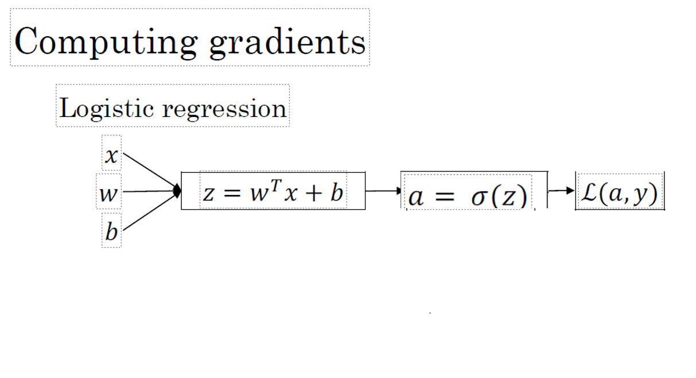

Slide 48
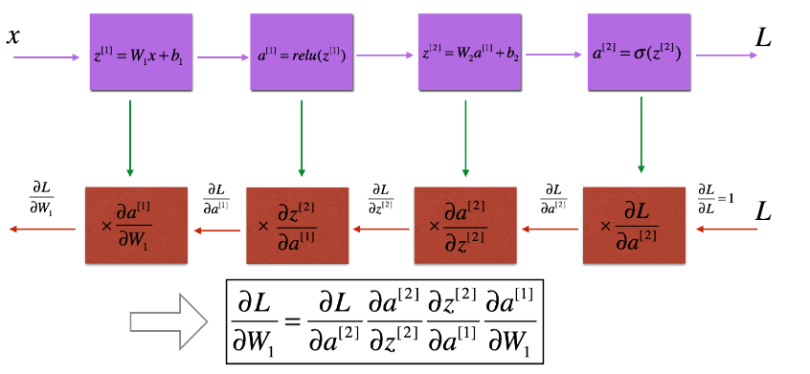
Neural network gradients

Slide 49
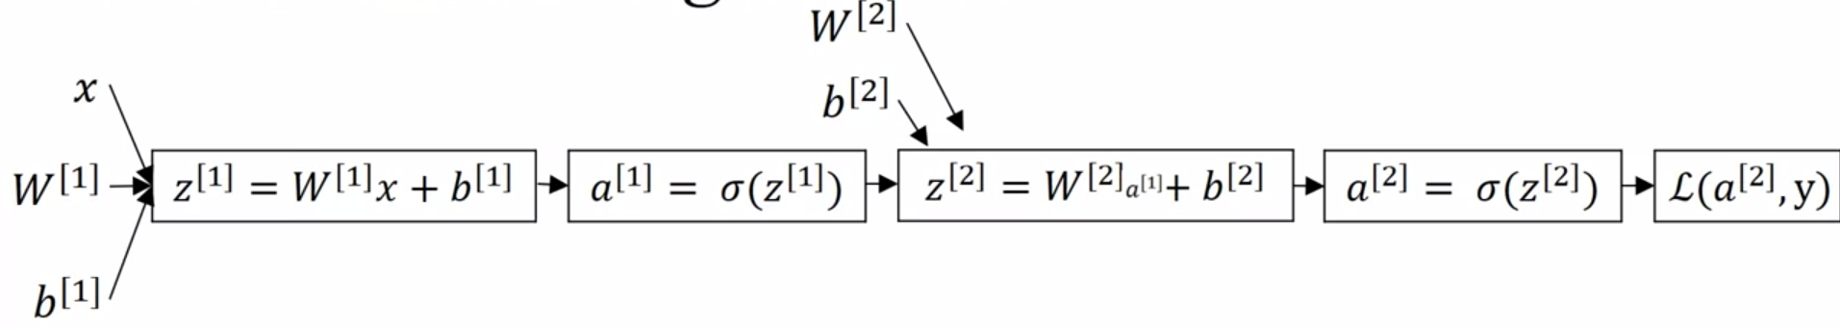





Neural network gradients
$$ⅆw^{\left[2\right]}$$
$$ⅆb^{\left[2\right]}$$
$$ⅆw^{\left[1\right]}$$
$$ⅆb^{\left[1\right]}$$

Slide 50
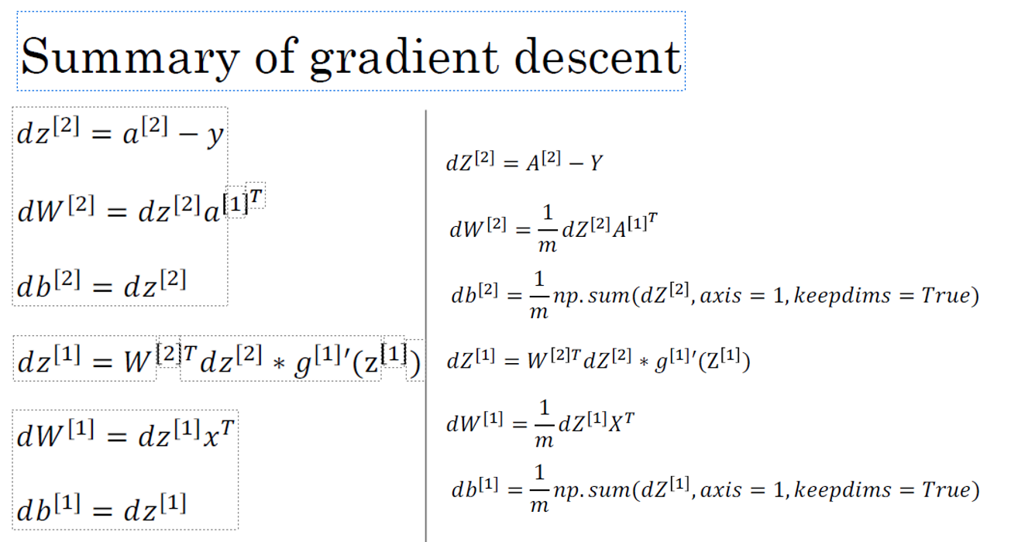

Slide 51
One hidden layer Neural Network
Random Initialization

Slide 52
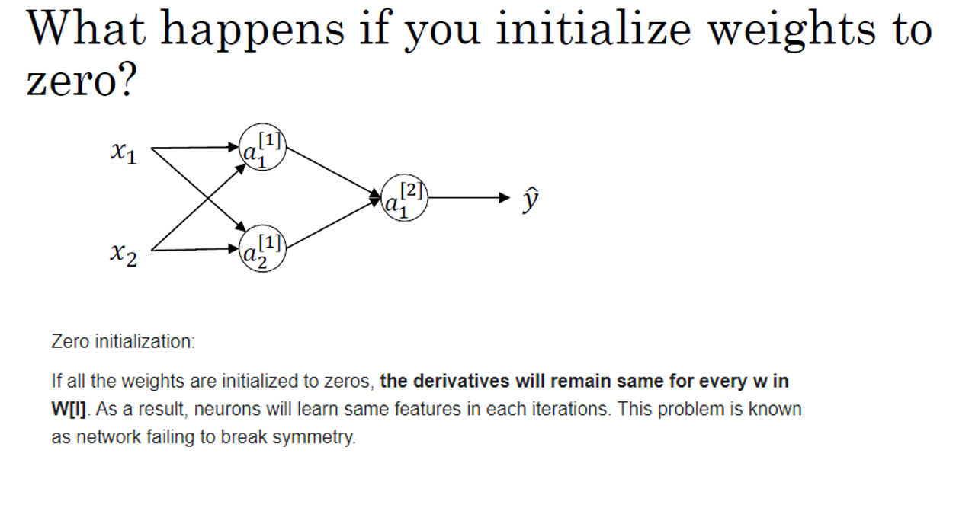

Slide 53
Random Initialization
Initializing neural network weights to all zeros results in symmetry and the hidden units computing the same function, leading to slow learning.
To solve this, the weights are initialized randomly with small values, such as 0.01, while biases can be initialized to zeros. Larger constants than 0.01 may be used for very deep neural networks.

Slide 54
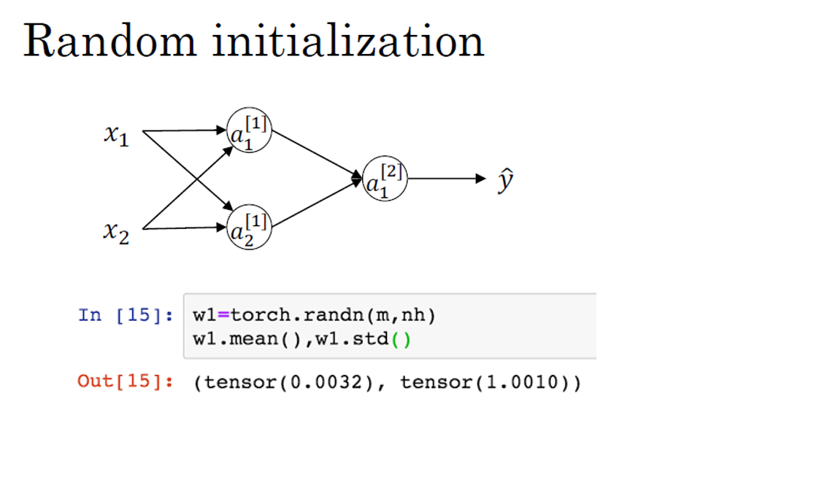

Slide 55
Summarization
Neural Networks are interconnected layers of neurons learning from data for predictions. They organize into input, hidden, and output layers, with neurons computing weighted sums and applying activation functions.
Computing the network's output involves propagating input through layers using weights, biases, and activations.
Vectorizing across examples enhances efficiency. Vectorized implementation speeds up training by processing multiple examples simultaneously.
Activation functions like sigmoid, tanh, and ReLU introduce non-linearity for learning complex patterns. Non-linear activation allows networks to approximate arbitrary functions.
Derivatives of activation functions are crucial for gradient calculations in backpropagation.
Gradient descent optimizes by adjusting weights and biases based on gradients to minimize the cost function.
Backpropagation propagates gradients backward through the network for parameter updates.
Proper weight initialization is vital for preventing symmetry and ensuring efficient learning.
Notes:
Neural Networks Overview:
- Introduction to neural networks as interconnected layers of neurons that learn from data to make predictions.
Neural Network Representation:
- Explains how neural networks are organized into layers: input, hidden, and output. Each neuron computes a weighted sum of inputs and applies an activation function.
Computing a Neural Network’s Output:
- Describes how to compute the output of a neural network by propagating the input through the layers using weights, biases, and activation functions.
Vectorizing across Multiple Examples:
- Shows how to perform computations for multiple training examples using matrix operations, enhancing efficiency.
Explanation for Vectorized Implementation:
- Details the benefits of vectorized computations in speeding up training by processing multiple examples simultaneously.
Activation Functions:
- Covers common activation functions like sigmoid, tanh, and ReLU, which introduce non- linearity and enable neural networks to learn complex patterns.
Why Do You Need Non-linear Activation Functions?
- Explains that non-linear activation functions allow neural networks to approximate arbitrary functions and capture intricate relationships in data.
Derivatives of Activation Functions:
- Discusses the derivatives of activation functions, which are crucial for gradient calculations during backpropagation.
Gradient Descent for Neural Networks:
- Introduces gradient descent as an optimization algorithm to adjust weights and biases based on calculated gradients, aiming to minimize the cost function.
Backpropagation Intuition:
- Provides an optional insight into the intuition behind backpropagation, where gradients are propagated backward through the network to update parameters.
Random Initialization:
- Highlights the importance of proper weight initialization to prevent symmetry and ensure efficient learning.

